Slide 1

FORAGE VIRTAL WORK EXPERIENCE
29/09/2023

Slide 2
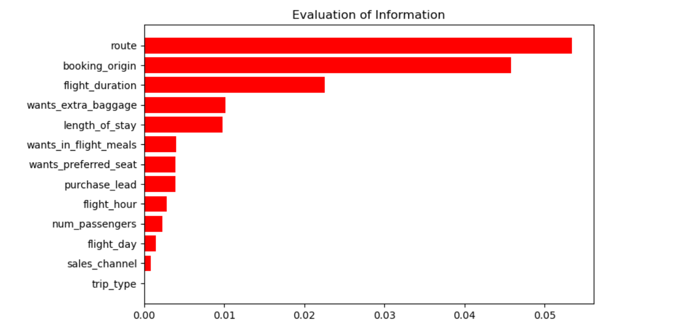
A MODEL TO ACKNOWLEDGE THE FACTORS THAT INFLUENCE THE CONSUMERS BEHAVIOUR
The top five most significant factors that impact customers expenditures are the following:
Route
Booking origin
Flight duration
Wanting extra baggage
Length of stay
ACCURACY: 83.86
Therefore, the AUC score needs to increase.
Factors
Importance

